Slide 1
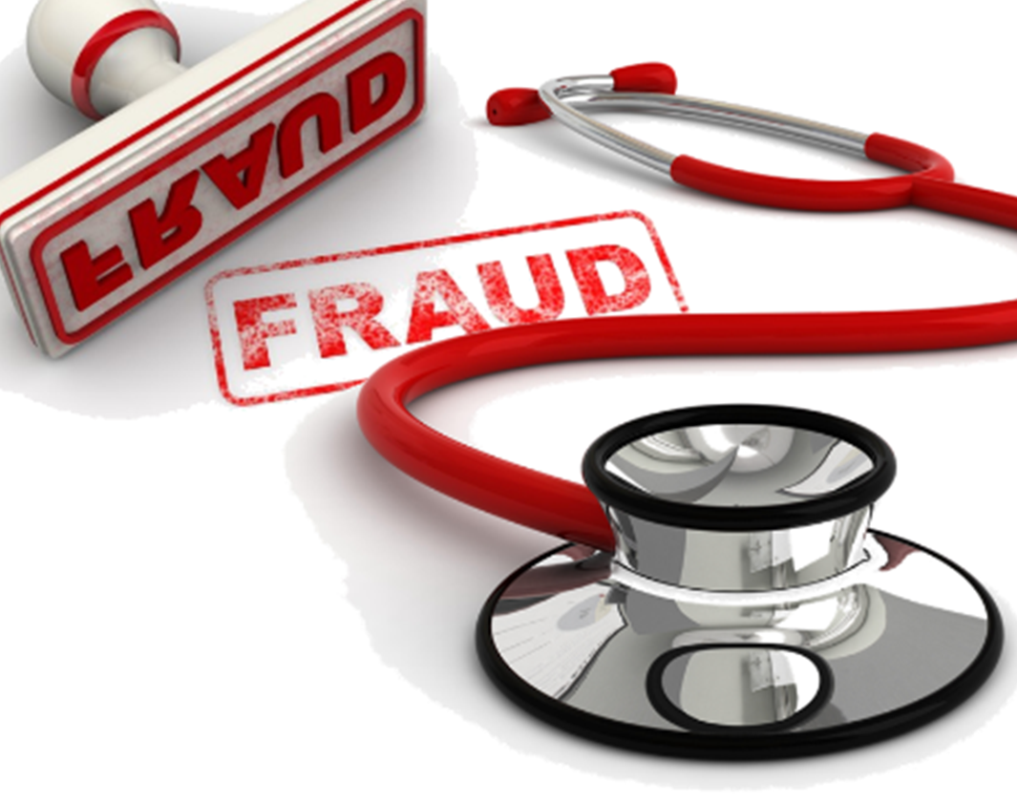
HEALTHCARE PROVIDER FRAUD DETECTION ANALYSIS
Arpan Shah - 0813493
Jay Modh - 0804365

Slide 2

What is Healthcare fraud?
Organized crime that involves peers of providers, physicians, and beneficiaries acting together to make fraud claims.
Insurance companies are most vulnerable institutions impacted due to these bad practice.
Some basic examples of healthcare fraud are:
Selling drugs, devices or medical cosmetics that have not been proven effective.
Billing of services or medical procedures which are not performed.
Notes:
Providers such as hospitals, cashiers, medical labs, nurses, lab assistant.
Beneficiaries means a person who drive advantage or receive benefits from financial products.
Insurance companies are most affected or institution due these fraud.
These scams can exist for any diseases like weight loss, memory loss, sexual performances, joint pain, and serious illness like cancer, diabetes, heart disease, arthritis and many more.
Other type of fraud is bogus marketing, in prescriptions, providing or billing for health services or equipment without license.

Slide 3
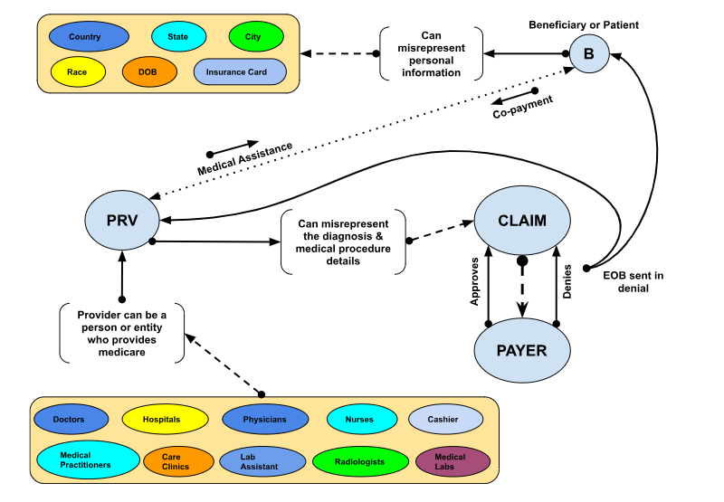
Notes:
This diagram describes how healthcare fraud occurs in real life.
EOB – Explanation of Benefits

Slide 4

Problem Statement
Healthcare fraud is a reprehensible violation of trust within an industry dedicated to safeguarding the well-being of individuals.
Faces significant challenges in identifying and preventing fraudulent activities perpetrated by healthcare providers.
Undermine the integrity of healthcare systems, potentially compromising patient care.
Notes:
In the healthcare industry, fraud is a serious issue that hurts trust and integrity.
Healthcare providers face challenges in identifying and preventing fraudulent activities.
Fraudulent claims not only result in substantial financial losses but also compromised patient care.

Slide 5

Project Objectives
Our goal is to examine healthcare provider data closely to spot unusual patterns and irregularities that may indicate fraudulent activities. By doing so, we aim to strengthen the honesty and trustworthiness of healthcare transactions.
Notes:
Our objective is to closely analyze healthcare provider data to identify unusual patterns and irregularities, which could signal fraudulent activities.
Through this process, we seek to enhance the honesty and integrity of healthcare transactions.

Slide 6
Dataset Information
Provider Data
Provider ID
Potential Fraud?
Beneficiary Data
Beneficiary ID
Date of Birth
Date of Death
Gender
Race
Chronic Disease
Reimbursed Amount
Deductible Amount
Inpatient Data
Claim ID
Beneficiary ID
Provider ID
Admission Date
Discharge Date
Attending Physician
Operating Physician
Outpatient Data
Claim ID
Beneficiary ID
Provider ID
Attending Physician
Operating Physician
Dataset Source: https://www.kaggle.com/datasets/rohitrox/healthcare-provider-fraud-detection-analysis/data
Notes:
Beneficiary Details Data
This data contains beneficiary KYC details like health conditions ,region they belong to etc.
Inpatient Data
This data provides insights about the claims filed for those patients who are admitted in the hospitals. It also provides additional details like their admission and discharge dates and diagnosis code.
Outpatient Data
This data provides details about the claims filed for those patients who visit hospitals and not admitted in it.

Slide 7

Demographic Study

Slide 8
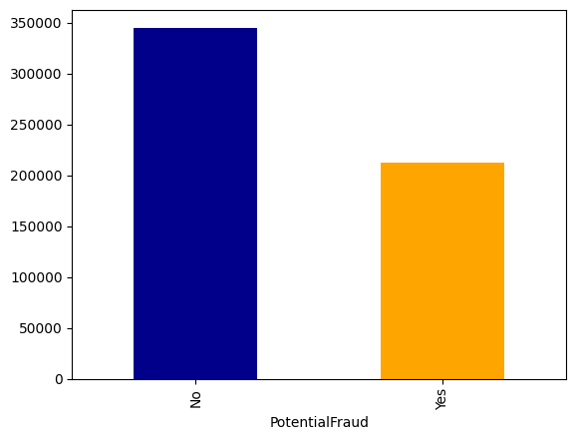
Distribution of Fraud and non-Fraud Cases
Significant portion of data indicates no potential fraud.
Presence of potential fraud is notable but less prevalent compared to absence.
Notes:
Further analysis required to understand factors contributing to potential fraud instances.
Strategies needed to mitigate potential fraud risks highlighted by the data.

Slide 9
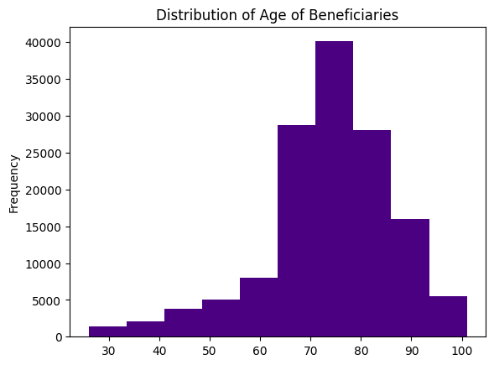
Distribution of Age of Beneficiaries
Most beneficiaries fall within the age range of 60 to 80. This suggests that a substantial portion of beneficiaries are in their senior years.
Beyond age 80, there’s a sharp decline in beneficiaries. This could indicate either fewer people in this age group or reduced access to benefits.

Slide 10
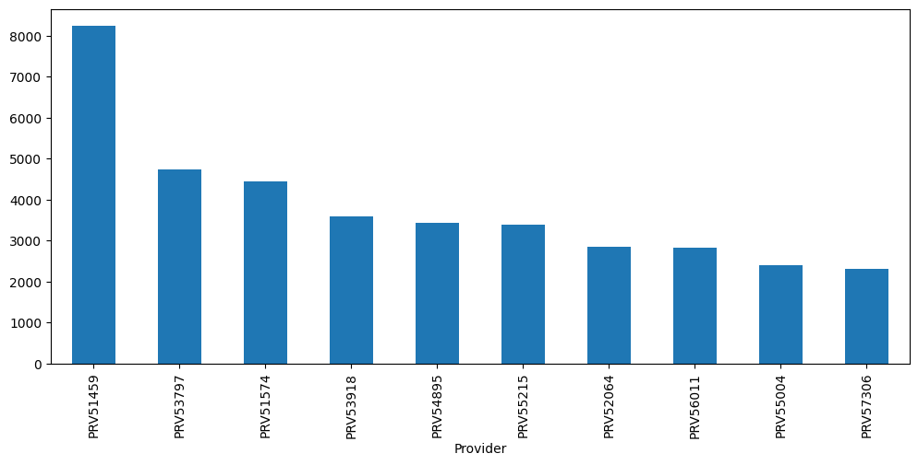
Top 10 Fraudulent Providers
Plot shows top-10 fraudulent providers with most percentage of Fraudulent Cases.
Here, PRV51459 has the highest percentage share of fraudulent case.

Slide 11
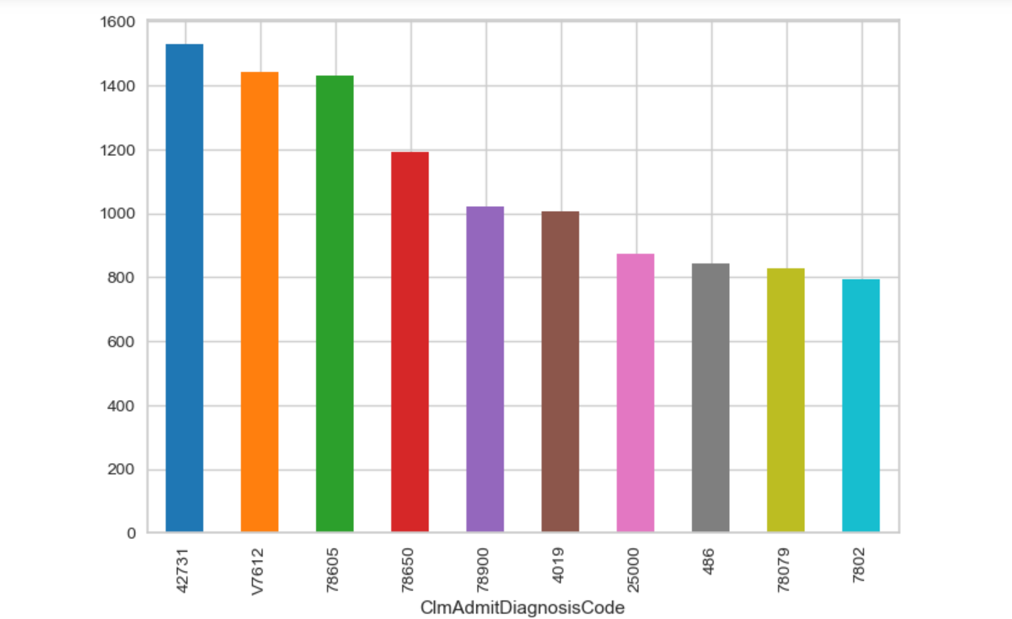
Top Diagnosis Codes for Fraudulent Cases
The diagnosis code 42731 has a high count of over 1500 potential fraud cases indicating it’s a common code associated with fraud.
Other codes like V7612, 78605, and 78650 also show high counts of potential fraud cases.
Notes:
V7612 - used for routine mammograms in individuals without reported breast abnormalities.
42731 – "Atrial fibrillation.its form of heart disease. Type of irregular heartbeat (arrhythmia) that can lead to complications such as stroke and heart failure.
78605 – shortness of breath
78650 – chest pain

Slide 12
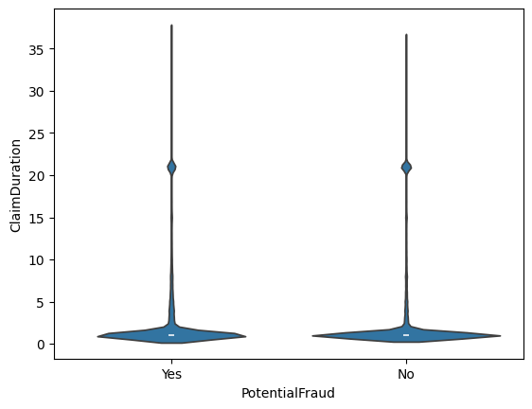
Claim Duration vs Potential Fraud
Most number of claims are filed for 3 days.
However, we can witness a little spike for 20 days of duration for claims.

Slide 13
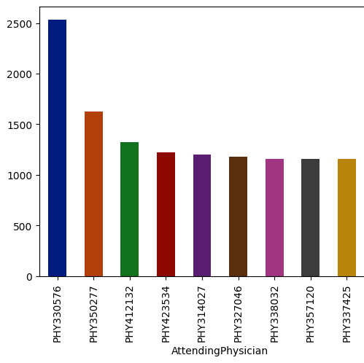
Top 10 Fraudulent Attending Physicians
PHY330576 has the highest percentage share of fraudulent cases. But the difference b/w other physicians is not so high.

Slide 14

Machine Learning Model Evaluation

Slide 15
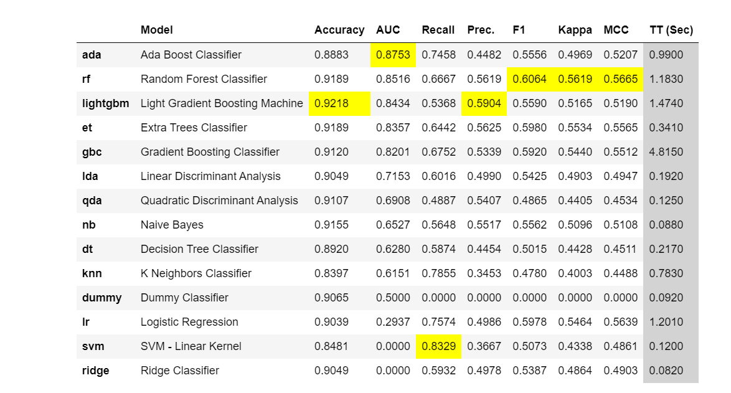
Accuracy of Various Models

Slide 16
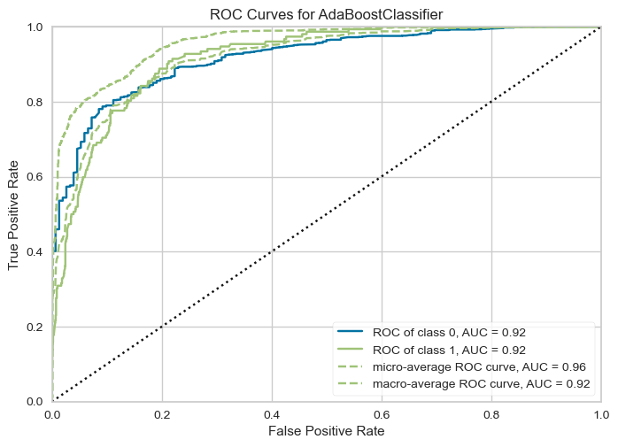
ROC Curve

Slide 17
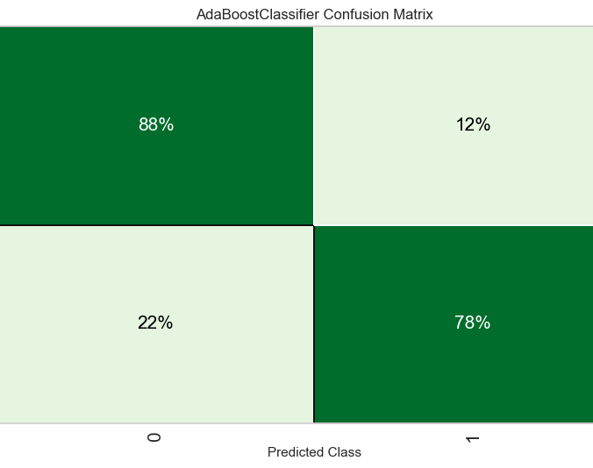
Confusion Matrix

Slide 18
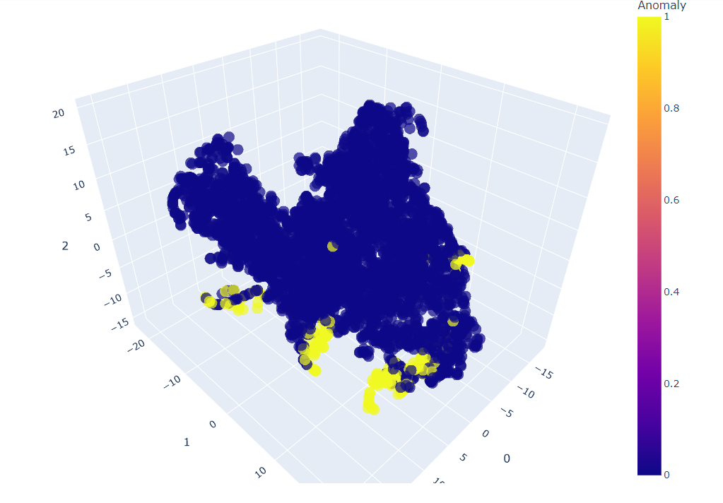
Anomaly Detection

Slide 19
Challenges
Lack of feature information
Imbalanced Data
Feature Selection

Slide 20
References
Dataset:
https://www.kaggle.com/datasets/rohitrox/healthcare-provider-fraud-detection-analysis/data
PyCaret:
https://pycaret.gitbook.io/docs/get-started/tutorials
Anomaly Detection:
https://www.analyticsvidhya.com/blog/2023/01/learning-different- techniques-of-anomaly-detection/

Slide 21

Questions / Answers

Slide 22

Thank You!

